Slide 1
CPSC 481 Artificial Intelligence
Mr. Ayush Bhardwaj
abhardwaj@fullerton.edu

Slide 2
What we will cover today
Coding search algorithms in Python
https://github.com/aimacode/aima-python

Slide 3
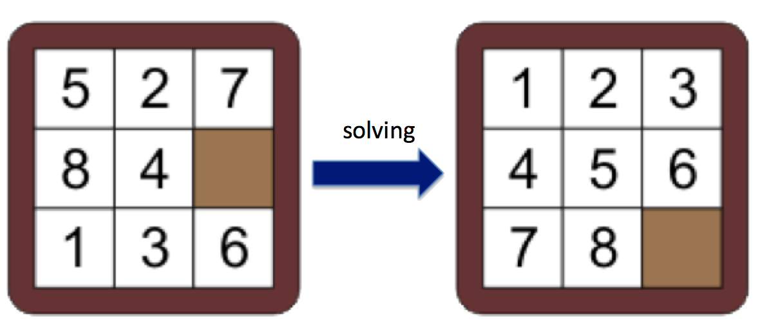
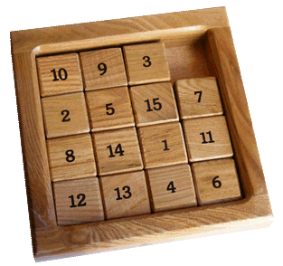
Sliding tile puzzle
solving
https://www.helpfulgames.com/subjects/brain-training/sliding-puzzle.html

Slide 4
State space of the sliding tile puzzle
State:
Sequence of tiles
Number of tiles
Dimensions of the board
Information on the board position

Slide 5
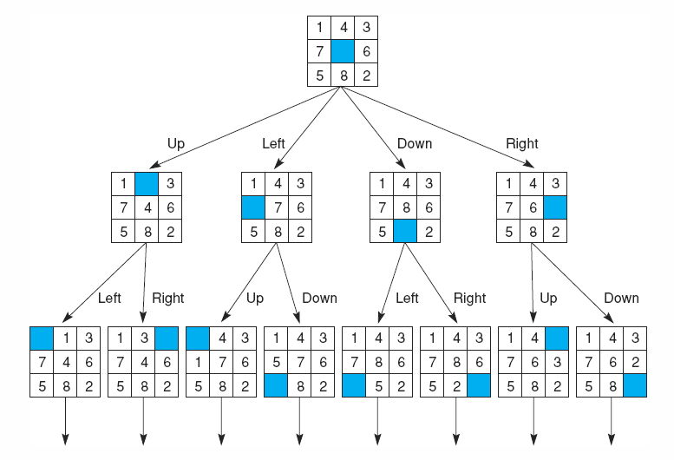
State space of the sliding tile puzzle
0
1
2
State:
A 9-element tuple/array
Blank represented by 0
For example:
(5,2,7,8,4,0,1,3,6)
Goal state?
3
4
5
6
7
8

Slide 6
State space of the sliding tile puzzle
operators: one for sliding each square in each of four directions
Better, one for moving the blank square in each of four directions
possible_actions = ['UP', 'DOWN', 'LEFT', 'RIGHT'] # Python list
What are the valid actions in a given state?

Slide 7
A State Space Graph for the 8-puzzle Generated by “move blank” Operations
*Search: Moving from an initial state to a goal state
Notes:
*What is GD for the 8-puzzle in previous slide? Board configuration for the goal state.

Slide 8
State space of the sliding tile puzzle
What are the valid actions in a given state?
def find_blank_square(self, state):
return state.index(0)
#Return the actions that can be executed in the given state.
def actions(self, state):
possible_actions = ['UP', 'DOWN', 'LEFT', 'RIGHT']
index_blank_square = self.find_blank_square(state)
if index_blank_square == 0:
return ['DOWN','RIGHT']
if index_blank_square == 1:
# ??

Slide 9
State space of the sliding tile puzzle
What are the valid actions in a given state?
#Return the actions that can be executed in the given state.
def actions(self, state):
possible_actions = ['UP', 'DOWN', 'LEFT', 'RIGHT']
index_blank_square = self.find_blank_square(state)
if index_blank_square % 3 == 0:
possible_actions.remove('LEFT')
if index_blank_square < 3:
possible_actions.remove('UP')
if index_blank_square % 3 == 2:
possible_actions.remove('RIGHT')
if index_blank_square > 5:
possible_actions.remove('DOWN')
return possible_actions

Slide 10
class Problem
A search problem has
Initial state
Goal state(s)
actions(state)
Method that returns valid actions in the given state
result(state, action)
Method that returns next state given current state, action
goal_test(state)
Is current state a goal?

Slide 11
class Node
class Node:
#A node in a search tree. def __init__(self, state, parent=None, action=None, path_cost=0):
#Create a search tree Node, derived from a parent by an action
self.state = state
self.parent = parent
self.action = action
def path(self):
#Return a list of nodes forming the path from the root to this node
node, path_back = self, []
while node:
path_back.append(node)
node = node.parent
return list(reversed(path_back))

Slide 12
Class work
Set up a python environment (if you haven’t)
Get started using Python on Windows for beginners
https://docs.microsoft.com/en-us/windows/python/beginners
Other environments
https://www.python.org/downloads/
Install numpy package
Download search.py, utils.py from
https://github.com/aimacode/aima-python

Slide 13
Create & execute “mytest.py”
from search import *
eight_puzzle = EightPuzzle((1, 2, 3, 4, 5, 7, 8, 6, 0))
if __name__ == '__main__':
print(eight_puzzle.find_blank_square((6, 3, 5, 1, 8, 4, 2, 0, 7)))
print(eight_puzzle.actions((0, 1, 2, 3, 4, 5, 6, 7, 8))) # DOWN, RIGHT
#print(eight_puzzle.result((0, 1, 2, 3, 4, 5, 6, 7, 8), 'DOWN'))
#print(eight_puzzle.goal_test((1, 2, 3, 4, 5, 6, 7, 8, 0))) #true
#print(eight_puzzle.goal_test((4, 8, 1, 6, 0, 2, 3, 5, 7))) #false
#print(eight_puzzle.check_solvability((0, 1, 2, 3, 4, 5, 6, 7, 8)))
#print(breadth_first_graph_search(eight_puzzle).solution())
#print(depth_first_graph_search(eight_puzzle).solution())
1
2
3
Solve the following puzzle:
5
7
8
4
8
6

Slide 14
References
AI textbook algorithms in Python
https://github.com/aimacode/aima-python
Get started using Python on Windows for beginners
https://docs.microsoft.com/en-us/windows/python/beginners

